Slide 1
Air quality forecasting using statistical and machine learning models in Schivenoglia area
Statistics for High Dimensional Data (S4HDD) and CompStat Lab a.a. 2023/2024 (2nd edition)
DATA
Febbraio 2024
Silviu Filote - 1059252 Jonathan Bommarito - 1068755

Slide 2
Outline
Introduction
Dataset description
Methodology
Statistical analysis
Machine learning analysis
Conclusions
Packages
References

Slide 3
Introduction

Slide 4
Air pollution, stemming from various sources including industrial activities, transportation, and agriculture, contributes to the degradation of air quality through the emission of primary pollutants and volatile organic compounds (VOCs). These emissions represents a serious threat to public health and the environment, necessitating a comprehensive understanding of its sources, dynamics, and impacts to formulate effective mitigation strategies. Our research purpose is to investigate Ammonia (NH3) compound using the daily observations in the Agrimonia dataset. We will apply a time series analysis approach and a machine learning one to see the differences between the 2 methods.

Slide 5
Ammonia facts
Ammonia (NH3) is one of the most produced inorganic chemicals worldwide, with a total global production of 109 million metric tons (Mt) in 2009 [1]
Ammonia is a widely used chemical with various industrial and agricultural applications. About 80% of the ammonia produced in industry is used in agriculture as fertilizer. Ammonia is also used as a refrigerant gas, to purify water supplies, and in the manufacture of plastics, explosives, fabrics, pesticides, dyes and other chemicals.
When NH3 enters the body because of breathing, swallowing or skin contact, it reacts with water to produce ammonium hydroxide. This chemical is very corrosive and damages cells in the body on contact.
Ammonia (NH3) serves as a key precursor gas for secondary particulate matter (PM), including both PM10 and PM2.5. [2]
The agricultural sector, particularly livestock and fertilizers, is widely recognized as a significant source of ammonia emissions, with up to 90% originating from this sector in Europe and an impressive 97% in the Lombardy region, Italy. [2]

Slide 6
Dataset description

Slide 7
Agrimonia overview
The Lombardy region, Italy, stands out as one of Europe's most polluted areas, primarily due to limited air circulation and elevated emission levels.
There exists a substantial scientific consensus attributing the agricultural sector as a significant contributor to the region's air quality issues.
The dataset includes daily observations from 2016 to 2021
The daily metrics includes air quality, weather patterns, emissions, livestock statistics, land and soil characteristics, providing a comprehensive view of environmental Lombardy’s dynamics.
The dataset is constructed by the AgrImOnIA project and contains 43 variables. NH3 will be used as response variable and the others as covariates in the further analysis [3]
We will take into the account only the data related to “Schivenoglia”, which comprehend 2192 observations from 1st January 2016 to 31st December 2021

Slide 8
Methodology

Slide 9
Implementing imputation robust techniques as well as the uncertainty to fill missing data within the variables’ time series
A) Block bootstrap
B) Kalman Smoother
Objective: analyze the Ammonia phenomenon using statistical and a machine learning approaches. Also understand which are the most significant covariates that influence Ammonia concentrations in the Schivenoglia location
Splitting the dataset into training (80%) and validation (20%)
Evaluate model dynamics by plots
Employing tuning processes and model selection techniques in the training phase to get the best model possible
Implement the best model and check the forecast performances and validation statistics: RMSE
Residual analysis and testing phase
Shapiro and Wilk test – H0: normality distribution
Breusch-Pagan Test – H0: homoscedasticity
Ljung-Box test – H0: no correlation
Statistical Analysis:
A) Linear regression
B) ARIMA models
In the machine learning analysis multiple models will be developed and compared with the others to see which one fits the best to the current case study. We will see:
A) XGBoost
B) Prophet, facebook's model
C) LSTM (Long short-term memory)

Slide 10
Statistical analysis

Slide 11
Kalman Smoother
Introduction to Kalman Smoother
An algorithm used in the analysis of dynamic systems and signal processing.
Extension of the Kalman filter, providing optimal estimates of the system state.
Difference between Kalman Filter and Kalman Smoother
Kalman filter provides "one-step-ahead" estimates based only on observed data up to that point.
Kalman smoother offers retroactive estimates using the entire sequence of available observations.
Utility of Kalman Smoother for Missing Values
Treatment of missing or incomplete values in time series.
Utilizes information from past and future observations to improve estimates of missing states.

Slide 12
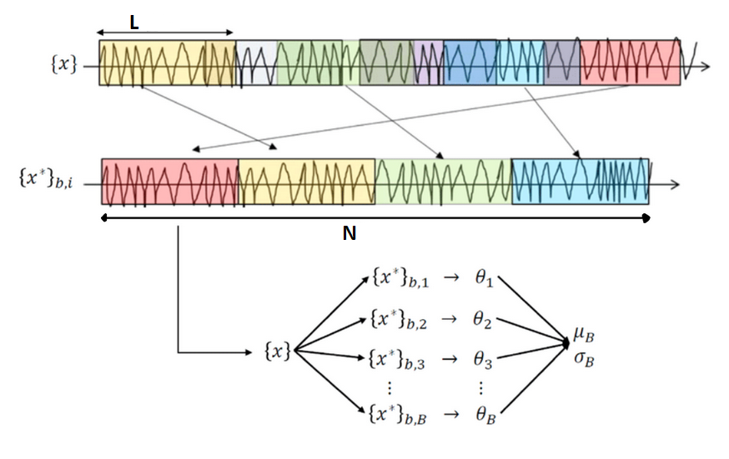
Block Bootstrap
“N”: Specifies the total number of samples (in this case, 2192).
“L”: Indicates the number of blocks size (in this case, 90).
“B”: Indicates the number of time series generated (in this case, 100).
Figure: Block Bootstrap [4]

Slide 13
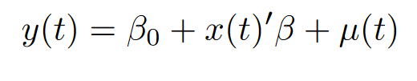
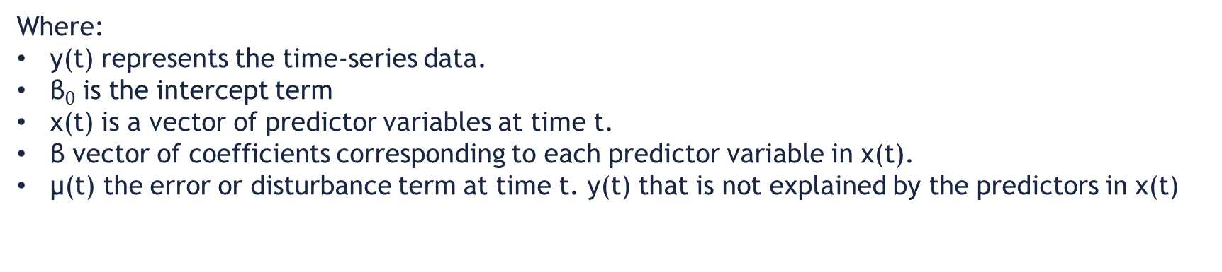
Linear regression
Linear regression model is defined with given equation:
Where:
y(t) represents the time-series data.
${\text{β}}_{0\text{​}}$is the intercept term
x(t) is a vector of predictor variables at time t.
β vector of coefficients corresponding to each predictor variable in x(t).
μ(t)​ the error or disturbance term at time t. y(t) that is not explained by the predictors in x(t)

Slide 14
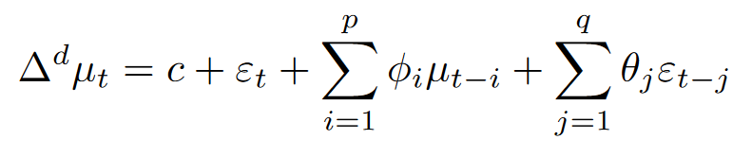
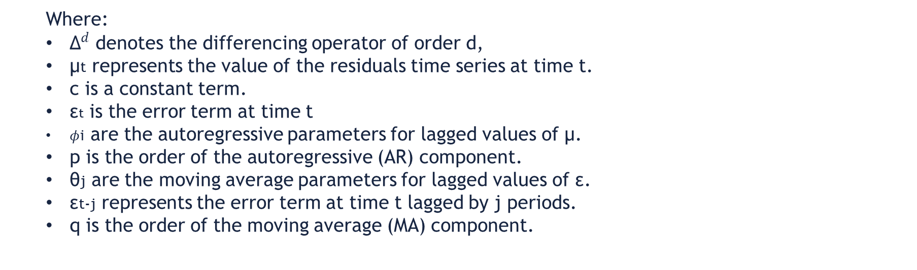
ARIMA model
ARIMA model is defined with given equation:
Where:
${\text{Δ}}^{d}$ denotes the differencing operator of order d,
μt​ represents the value of the residuals time series at time t.
c is a constant term.
εt​ is the error term at time t
$φ$i​ are the autoregressive parameters for lagged values of μ.
p is the order of the autoregressive (AR) component.
θj​ are the moving average parameters for lagged values of ε.
εt-j​ represents the error term at time t lagged by j periods.
q is the order of the moving average (MA) component.

Slide 15
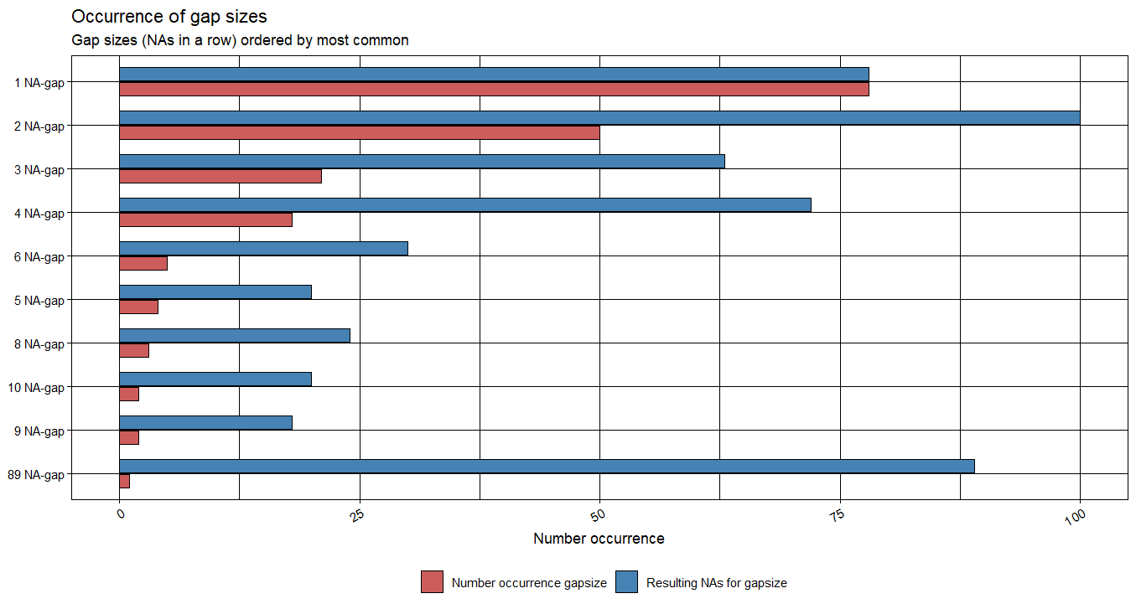

Slide 16
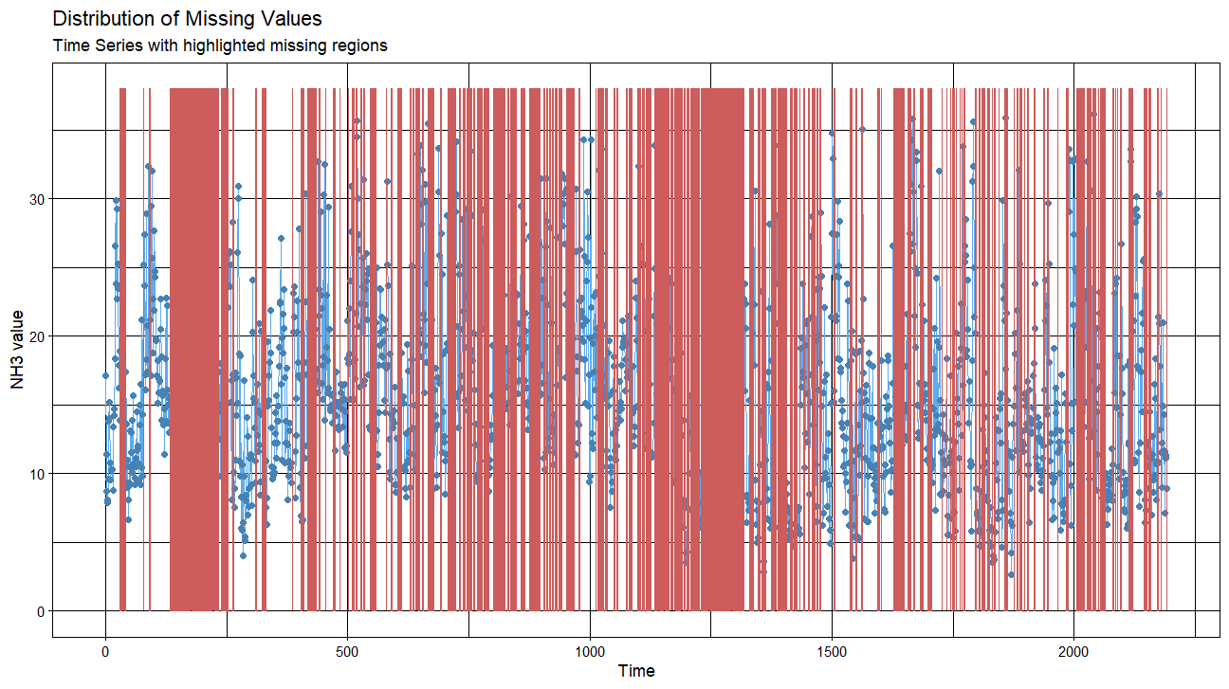

NH3 distribution
Time Series with highlighted missing regions
$$μg/m^{3}$$

Slide 17
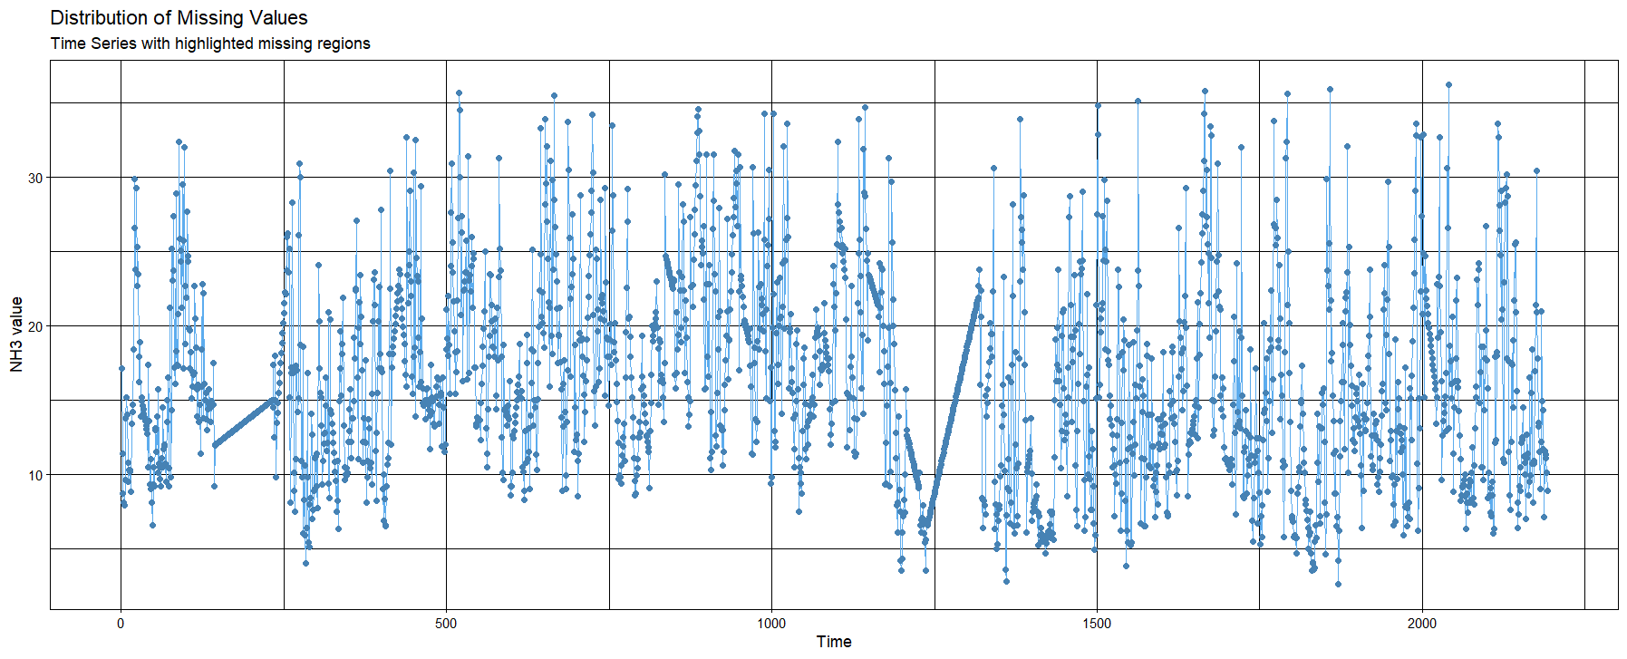

Kalman Smoother implementation
NH3 distribution
Time Series with highlighted missing regions
$$μg/m^{3}$$

Slide 18
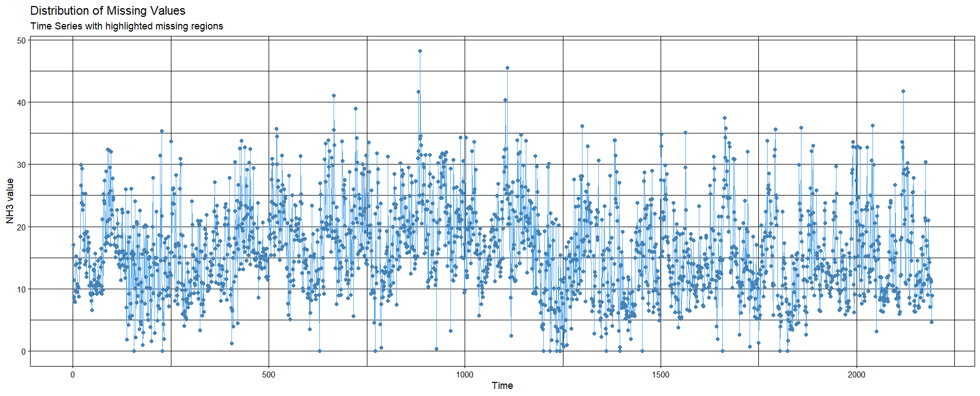

Kalman Smoother + Block Bootstrap
NH3 distribution
Time Series with highlighted missing regions
$$μg/m^{3}$$

Slide 19
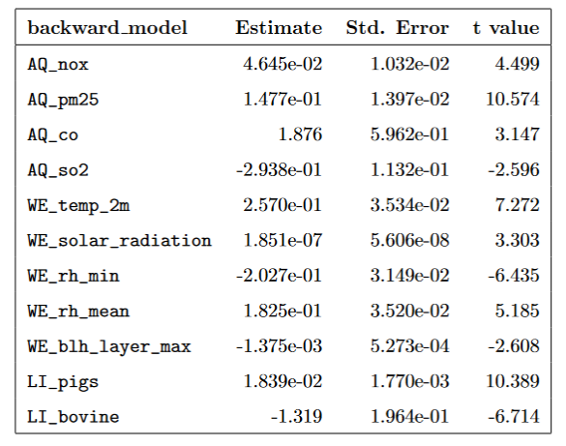
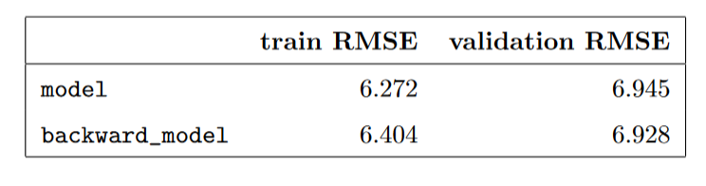
Linear model
Backward Stepwise algorithm applied to obtain the best model
RMSE metric used for evaluation

Slide 20
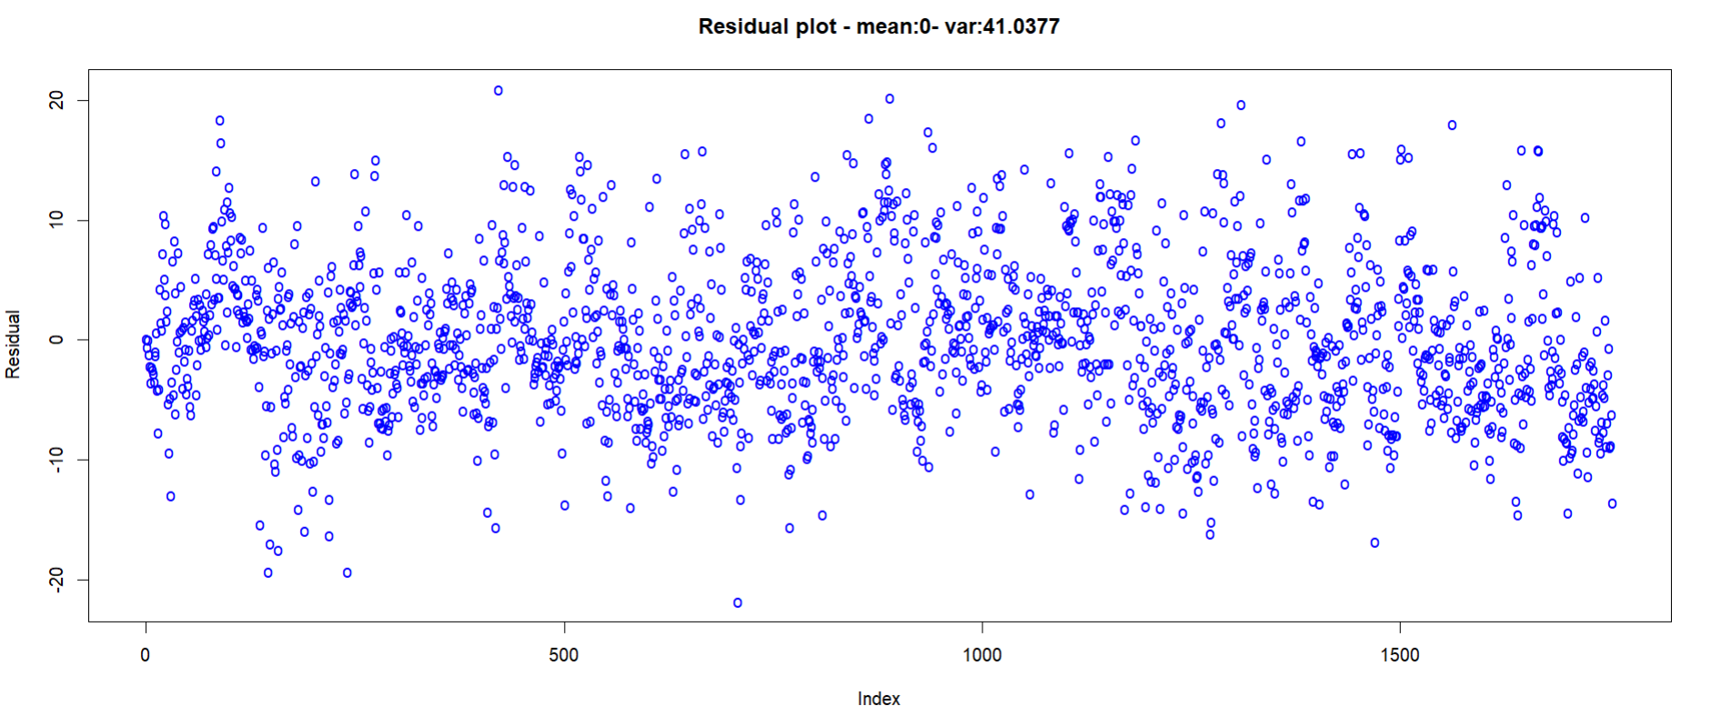
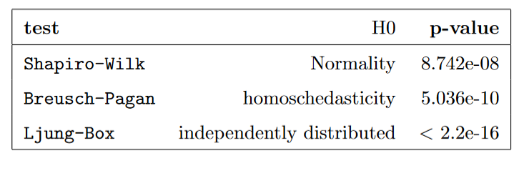
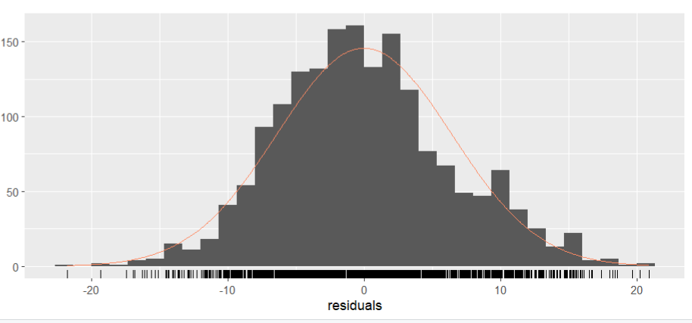
Residuals Analysis

Slide 21
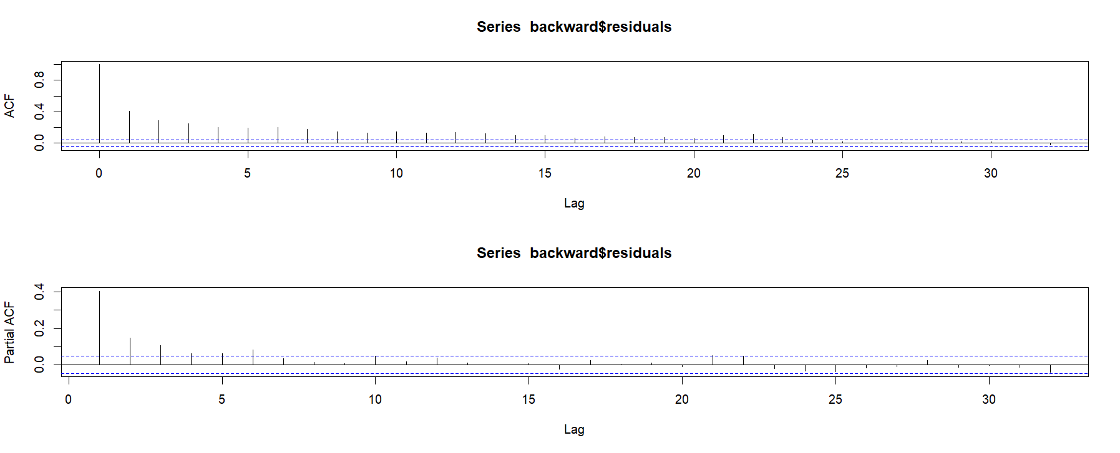



Slide 22
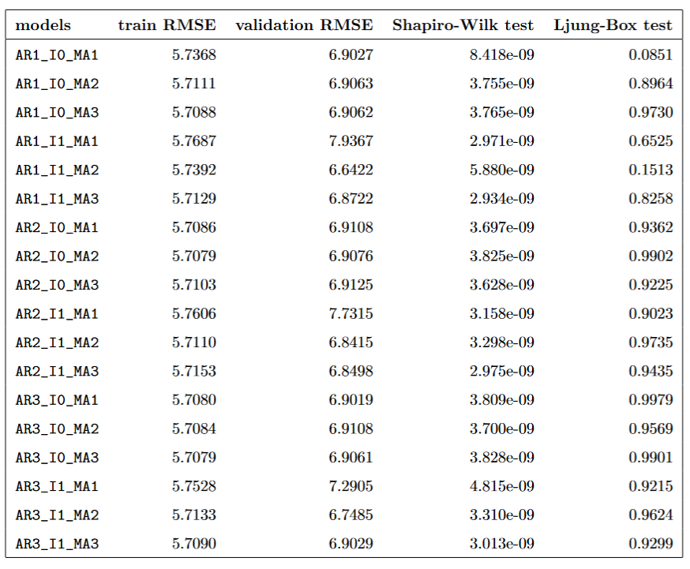
ARIMA Implementation
Various combinations of AR (AutoRegressive), I(Integretion), MA (Moving Average) values were tested for the ARIMA model.
After evaluating the performance of each combination, considering RMSE on the validation data, Ljung-Box test, and Complexity, the ARIMA model with the AR1_I0_MA2 combination was selected as the best.

Slide 23
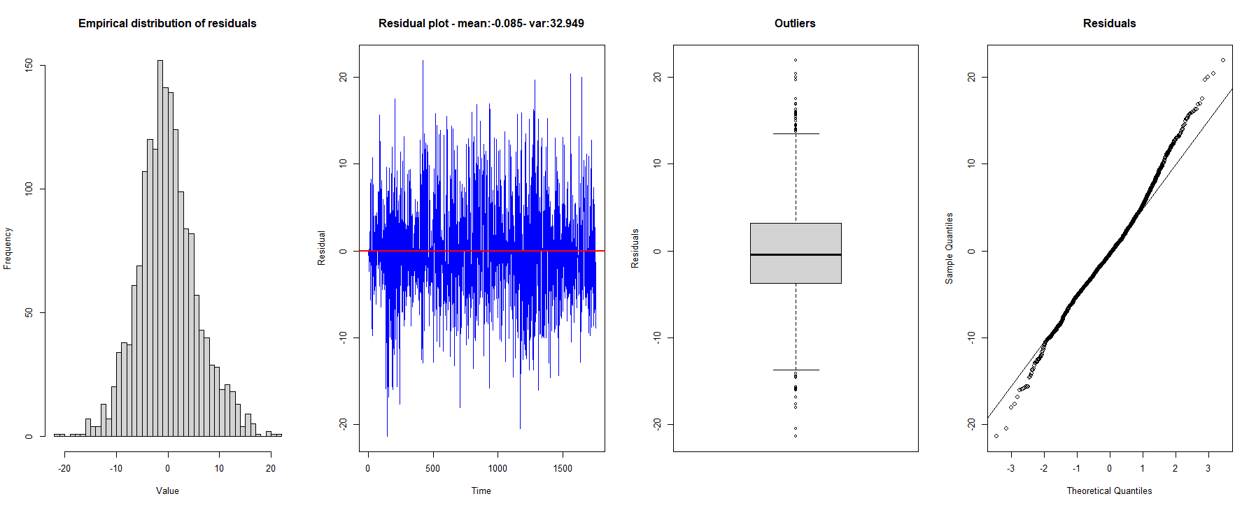
ARIMA Residuals Analysis

Slide 24
Machine learning analysis

Slide 25
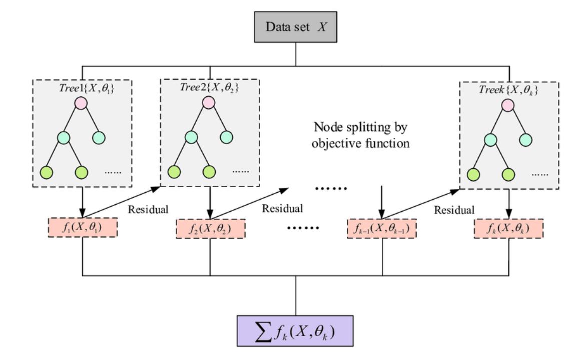
XGBoost
XGBoost (eXtreme Gradient Boosting) is a decision tree-based ensemble algorithm that leverages the concept of gradient boosting to create a strong model
XGBoost works by creating a set of decision trees iteratively, each tree attempting to correct the mistakes of the previous tree. The algorithm employs a gradient descent algorithm to minimize a cost function, which is the sum of the errors of each tree in the ensemble.
The final model is a weighted combination of all the decision trees, with each tree assigned a weight based on its contribution to the cost function.
Figure: XGBoost model schematics [5]

Slide 26
Algorithm steps:
Initialize the model
Fit the first tree
Compute the loss
Fit the next tree
Make predictions
Advantages of XGBoost:
Building decision trees as weak learners and performing tree pruning
Implementing Shrinkage technique in the Gradient Descent algorithm
Calculates feature importance by measuring its contribution to the loss reduction
Scalibility, flexibility, regularization and speed
Disadvantages
Overfitting problems
Hyperparameter Tunings
Trees can be very non-robust

Slide 27
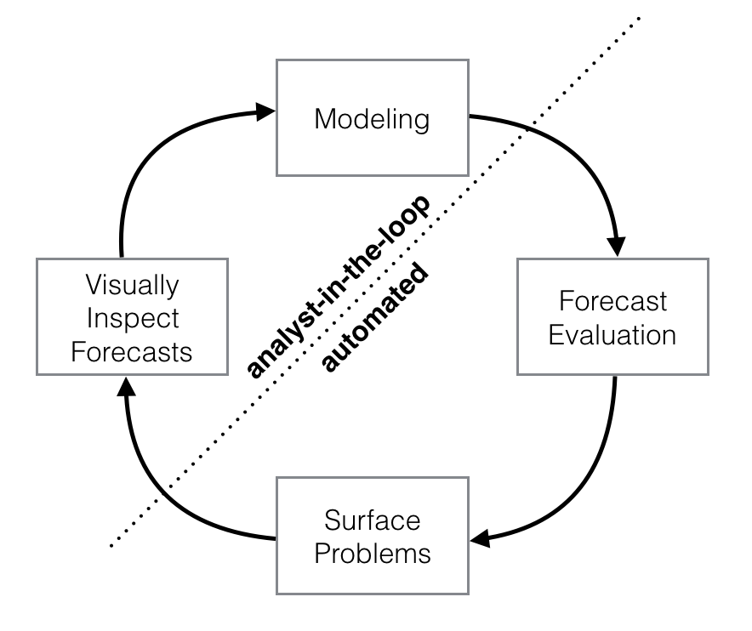
Prophet
Prophet is a model for forecasting time series data based on an additive regression model where non-linear trends are fit with yearly, weekly, and daily seasonality, plus holiday effects
It works best with time series that have strong seasonal effects and several seasons of historical data
Prophet is robust to missing data and shifts in the trend, and typically handles outliers well.
Prophet automatically detects and models various components of time-series data including trend, seasonality, and holiday effects.
Prophet automates much of the forecasting process and involves statistical techniques that may be complex to some users
Figure: Prophet model logic [6]

Slide 28
Prophet procedure is an additive regression model with four main components:
Trend component
Seasonal seasonal component modeled using Fourier series/dummy variables.
Holiday effect, user can provide list
Random error
Advantages of Prophet:
Prophet makes it much more straightforward to create a reasonable, accurate forecast
Uncertainty Estimation
Disadvantages
Limited Flexibility in the customization options
seasonal patterns are only additive

Slide 29
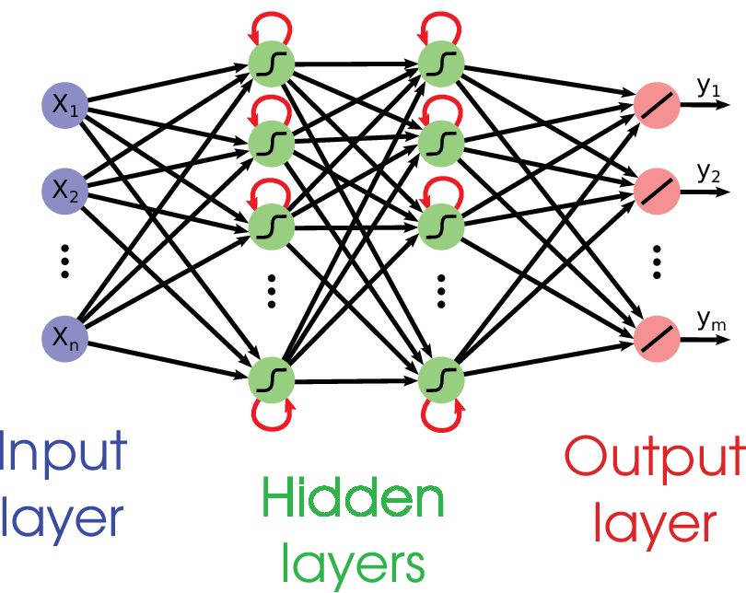
LSTM
A neural network is a collection of algorithms designed to learn the patterns in observed
Training phase aims to adjust the weight between neurons
Recurrent Neural Network (RNN) allows to propagate the information among nodes creates long-term dependencies therefore, to process sequences.
Training the RNN with long term temporal dependencies leads to vanishing gradient problem
LSTM (Long Short Term Memory network) networks fix the vanishing gradient problem, implementing a more complex structure
LSTM networks has the same propagation logics as RNN, however the information is processed in a different way
Figure: Example of a RNN architecture [7]

Slide 30
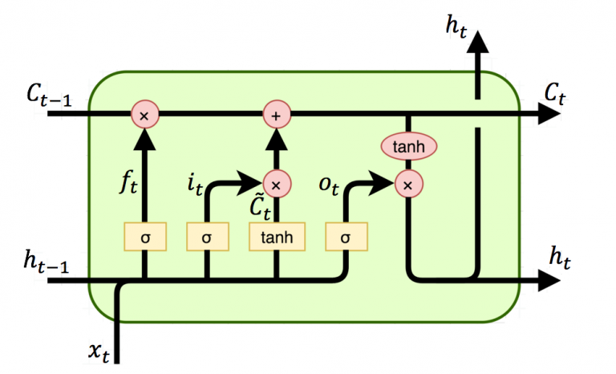
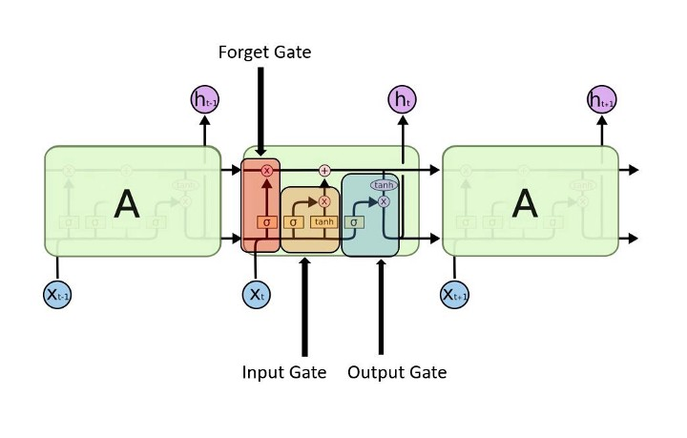
The module structure of the LSTM network is composed by:
Input gate
Forget gate
Output gate
The LSTM network is composed by chain formed by repeating the same module
Advantages:
Long-term dependency modeling
Robustness to noise and irrelevant information
Disadvantages:
Complexity
Computationally intensive
Overfitting
Figure: One module of the LTSM network [7]
Figure: repeating module in an LSTM [7]

Slide 31
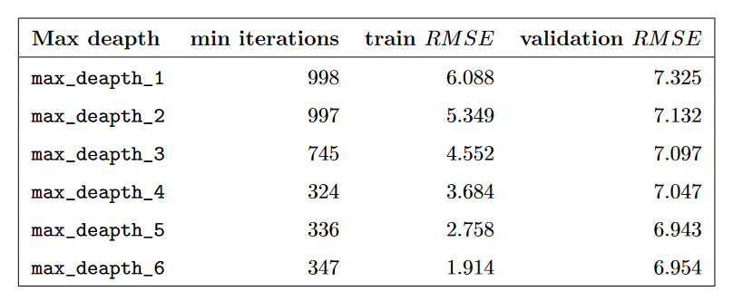
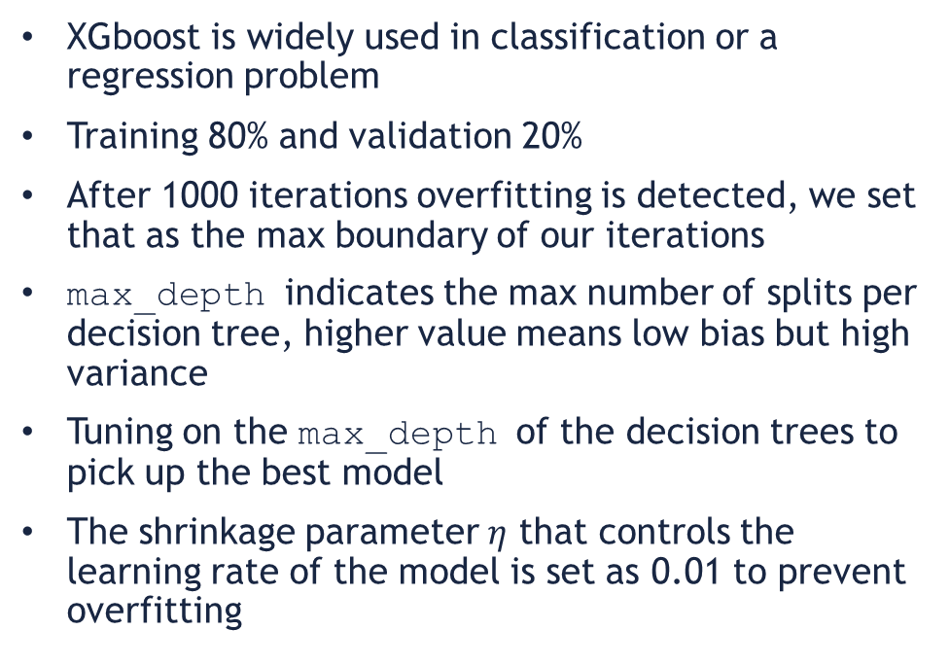
XGBoost implementation
XGboost is widely used in classification or a regression problem
Training 80% and validation 20%
After 1000 iterations overfitting is detected, we set that as the max boundary of our iterations
max_depth indicates the max number of splits per decision tree, higher value means low bias but high variance
Tuning on the max_depth of the decision trees to pick up the best model
The shrinkage parameter $η$ that controls the learning rate of the model is set as 0.01 to prevent overfitting
Figure: Tuning on max_depth parameter

Slide 32
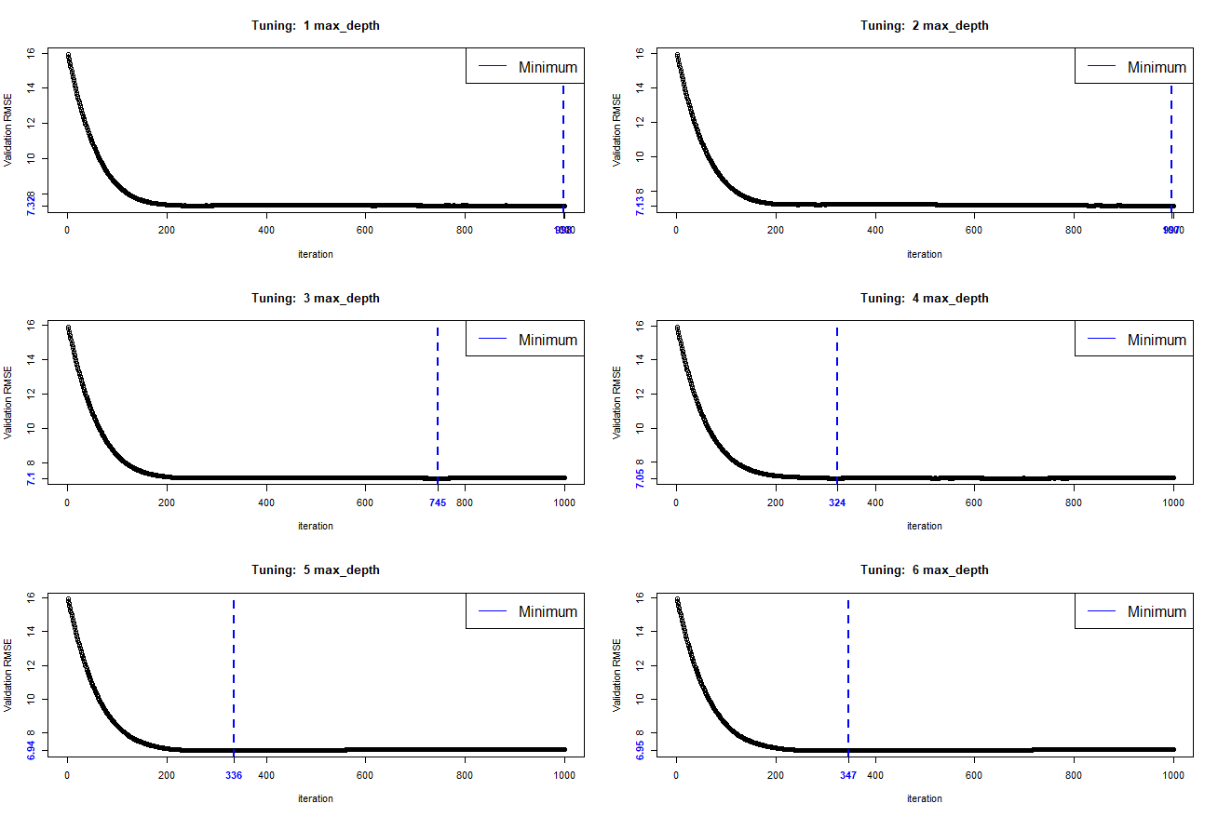
Figure: Tuning plots of max_depth parameter

Slide 33
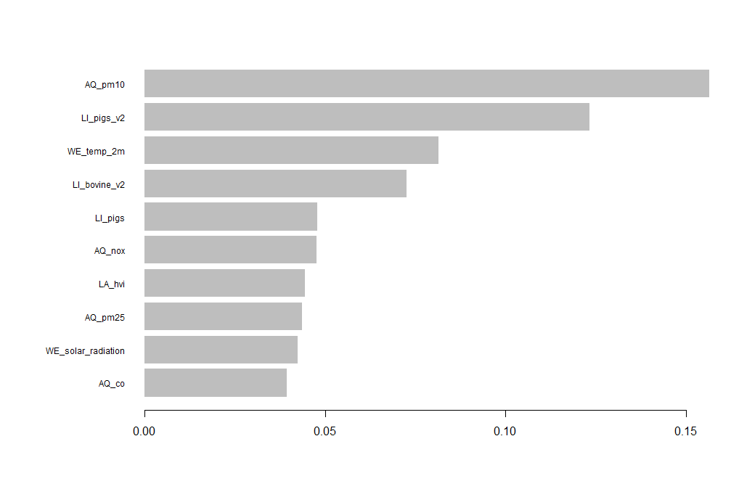
Figure: Gain of the 10 most important features used for splitting in the decision trees

Slide 34
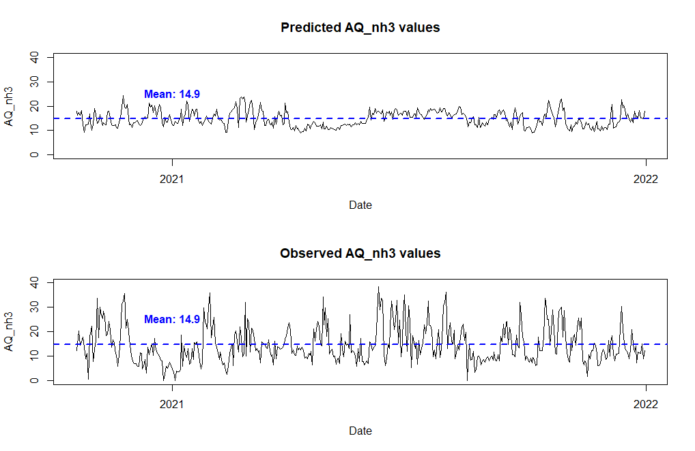
Figure: comparing predicted vs observed of AQ_nh3

Slide 35
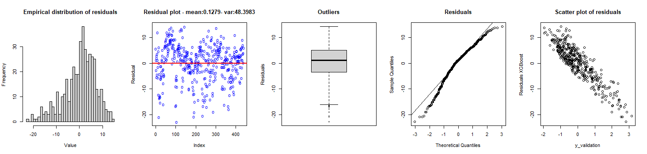
Figure: Residual behavior in validation

Slide 36

Prophet implementation
Training 80% and validation 20%
Add holidays component to the model as a list
Add regressors to the model
Automatic additive decomposition in the 4 components
Customize plots offer by the library
Residual analysis and testing
Figure: where, y(t) refers to the forecast g(t) refers to the trend s(t) refers to the seasonality h(t) refers to the holidays for the forecast e(t) refers to the error term while forecasting [8]

Slide 37
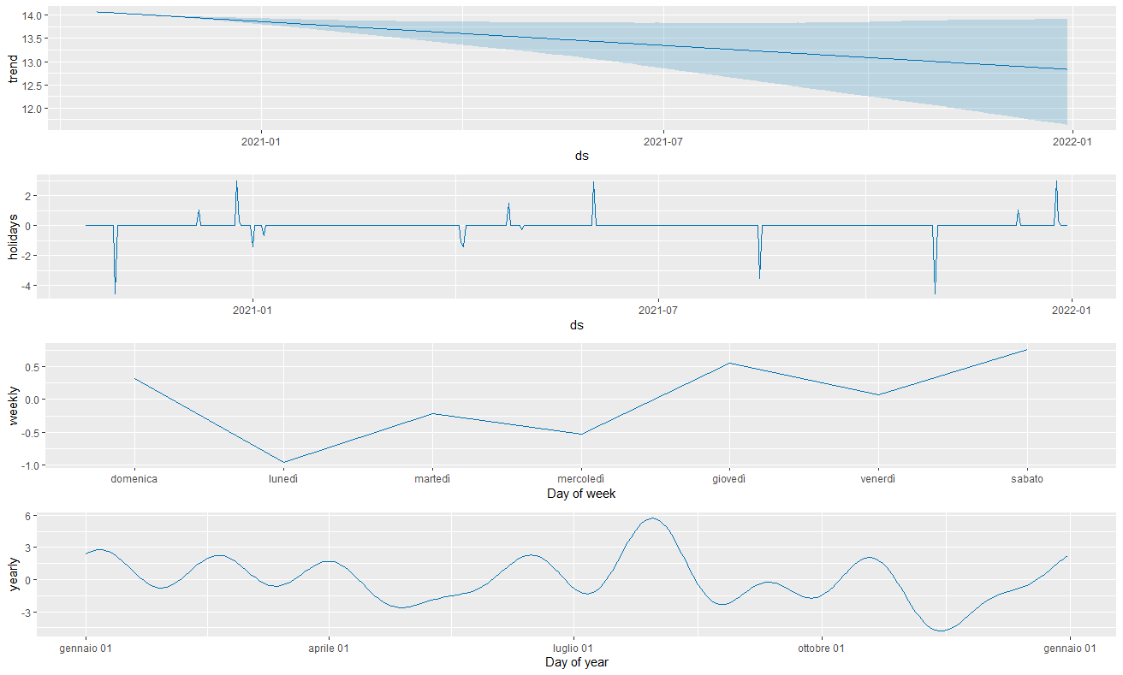
Figure: additive model decomposition over the validation set

Slide 38
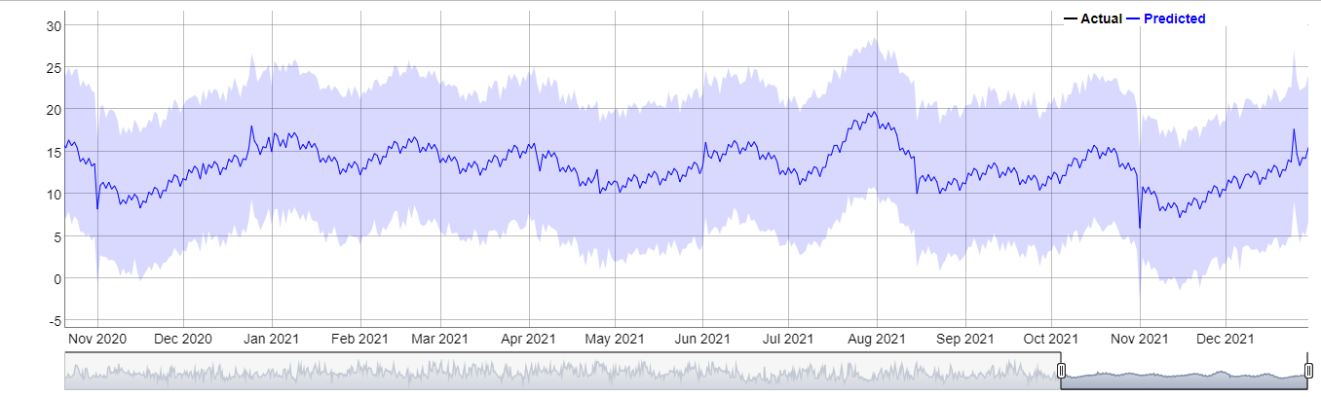

$$μg/m^{3}$$
Figure: predicted AQ_nh3

Slide 39
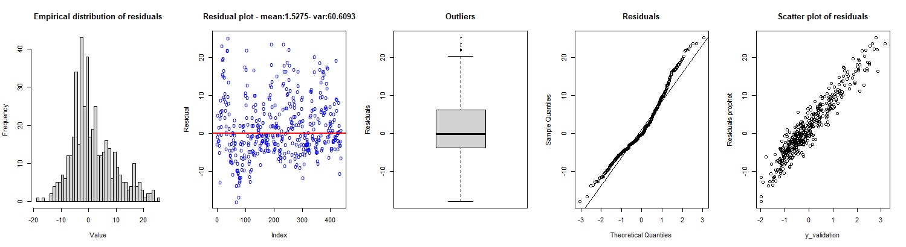
Figure: Residual behavior in validation

Slide 40
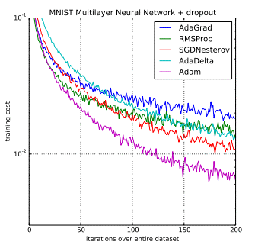
LSTM implementation
Training 80% and validation 20%
Minimizing a loss function in the training phase: MSE
Optimizer used to update the weights of the parameters involved: Adam optimizer
Adaptive Learning Rate
Bias Correction
robustness and effectiveness in training
Computationally efficient
num_epochs, the number of times the entire dataset will be passed forward and backward through the network during the training process
Tuning on to num_epochs avoid overfitting
Residual analysis and testing
Figure: In “An overview of gradient descent optimization algorithms” Sebastian Ruder says: “Adam might be the best overall choice” [9]

Slide 41
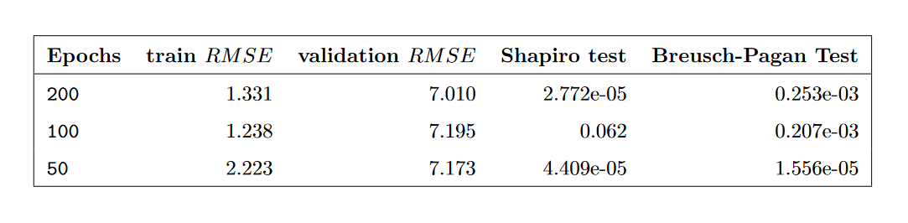
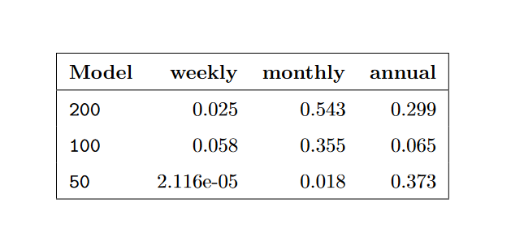
Figure: tuning on num_epochs and results
Figure: Ljung-Box tests executed to see any weekly, monthly or annual correlation between residuals

Slide 42
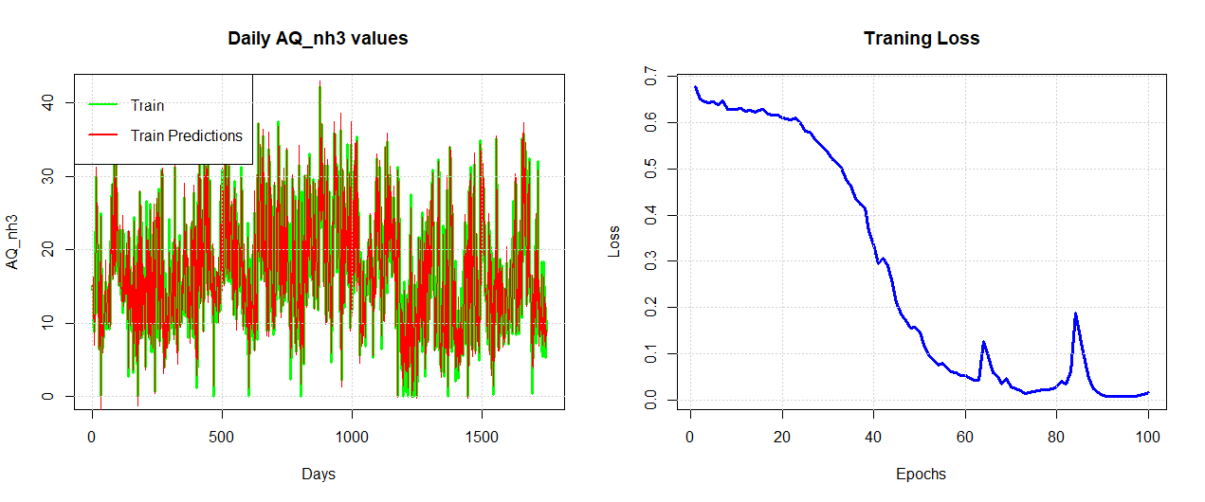
Figure: training LSTM network minimizing the loss function

Slide 43
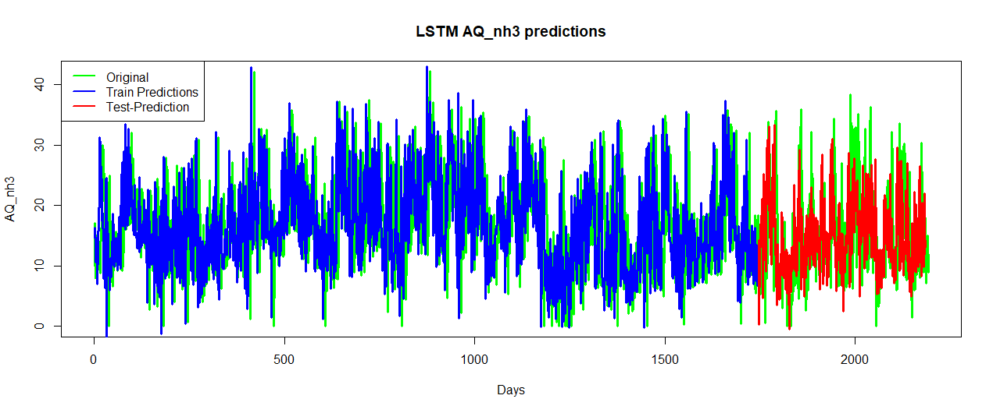
Figure: predicted AQ_nh3 by the LSTM model

Slide 44
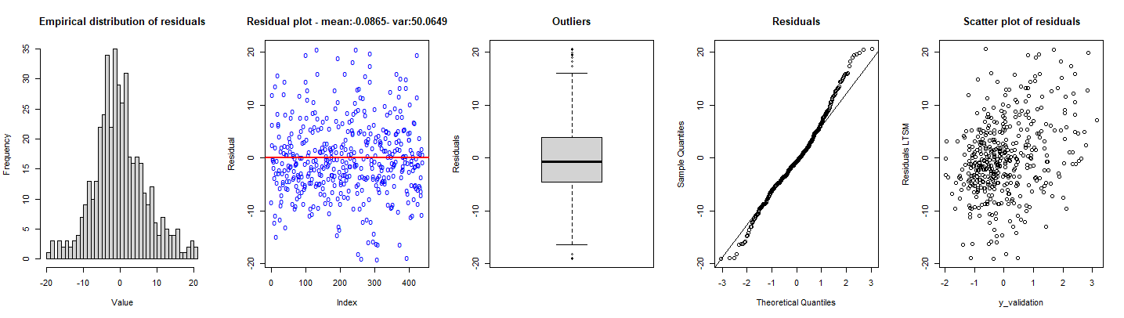
Figure: Residual behavior in validation

Slide 45
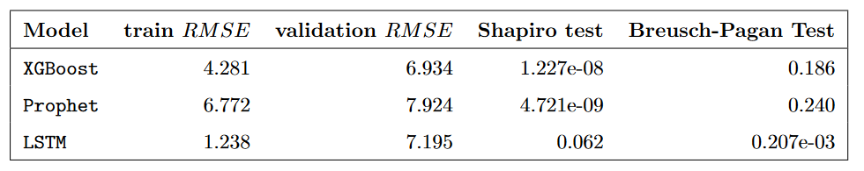
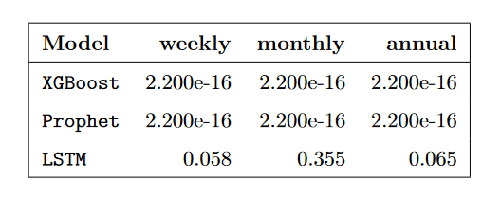
Machine learning conclusions
Figure: model statistics
Figure: Ljung-Box results

Slide 46
Packages
library(bboot)
library(ggplot2)
library(bboot)
library(forecast)
library(imputeTS)
library(stats)
library(lmtest)
library(tseries)
library(xgboost)
library(prophet)
library(keras)

Slide 47
References
[1] Gilbert P, Thornley P, Alexander S, Brammer J. Biomass gasification for ammonia production. International conference on polygeneration strategies; Sep 2009; Vienna. 2009
[2] Fassò, Alessandro, et al. "Agrimonia: a dataset on livestock, meteorology and air quality in the Lombardy region, Italy." Scientific Data 10.1 (2023): 143.
[3] A. Fassò, «AgrImOnIA: Open Access dataset correlating livestock and air quality in the Lombardy region, Italy». Zenodo, mag. 31, 2023. doi: 10.5281/zenodo.7956006.
[4] Boufidi, E., Lavagnoli, S., & Fontaneto, F. (2020). A probabilistic uncertainty estimation method for turbulence parameters measured by hot-wire anemometry in short-duration wind tunnels. Journal of Engineering for Gas Turbines and Power, 142(3), 031007.
[5] Guo, Rui, et al. "Degradation state recognition of piston pump based on ICEEMDAN and XGBoost.“ Applied Sciences 10.18 (2020): 6593
[6] Prophet: forecasting at scale, By: Sean J. Taylor, Ben Letham, February 23, 2017

Slide 48
[7] Loza, J. M. S. (2019). Shape sensing of deformable objects for robot manipulation (Doctoral dissertation, Université Clermont Auvergne [2017-2020]).
[8] Time Series Analysis using Facebook Prophet in R Programming, geeksforgeeks.org, 22 Jul, 2020
[9] Sebastian Ruder. An overview of gradient descent optimization algorithms, 2017.

